Slide 1
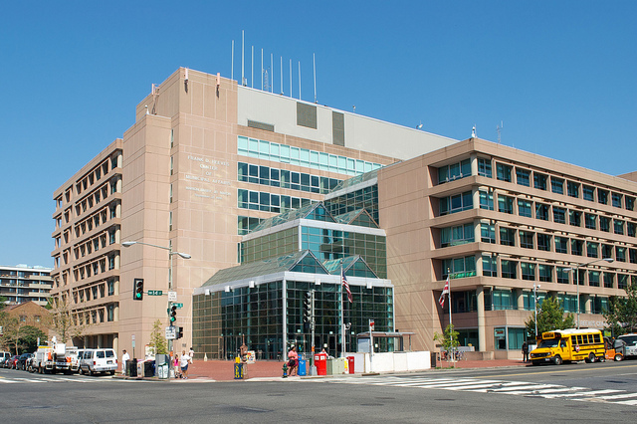
Predicting Building Electricity Use
Frank D. Reeves Center of Municipal Affairs
How many birds….
14th & U St NW, Washington, DC

Slide 2
Problem Statement and Goals
Problem Statement:
Predictions of building electricity usage are needed to aid the Government of the District of Columbia in electricity analysis and budgeting for their buildings.
SMART Goals:
Develop a model to predict a given building's electricity usage for each month in 2017 within 10% of the actual usage based on historical data (electricity usage, weather, etc.) from the years 2013-2016.
How many birds….

Slide 3
Data Acquisition
API Access
Pepco Electricity Data:
http://www.buildsmartdc.com
Downloadable CSV
DCA Weather Data:
http://openweathermap.org/
Manipulatable Spreadsheet
DC Sunlight Data:
https://www.esrl.noaa.gov/gmd/grad/solcalc/calcdetails.html
Manual
DC Gov’t Operating Schedule:
https://dchr.dc.gov/page/holiday-schedules

Slide 4
Feature Creation
Time Period:
Interval = Daily
Train Period = 2013 through 2016
Test Period = 2017
Features:
Heating Degree Days
# of Degrees * # of Days < 65 F Outside
Cooling Degree Days
# of Degrees * # of Days > 65 F Outside
Sunlight
Minutes of Sunlight per Day
Workday
Binary, 1 if Official DC Gov’t Workday else 0

Slide 5
Modeling Results
Modeling Approach:
Linear Regression
Feature Tuning utilized annual-Folds of the Training Data
Results:
6 of 12 Months were predicted within 10% of the actual electricity usage.
Annual predicted Electricity usage was off by 11% from the actual usage.
11,834 hours of Weather data were missing and filled by interpolation
2,300 hours of Electricity data were missing and filled with 0’s
The Months-of-Year with the 4 highest quantities of missing Electricty usage data averaged 28% error.
Predictions in the summer were generally better than those in Winter.

Slide 6
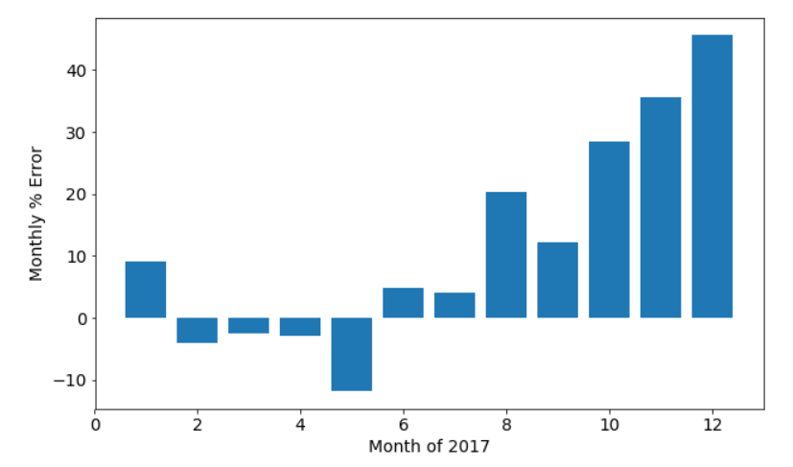
Bar Graph of Monthly % Error

Slide 7
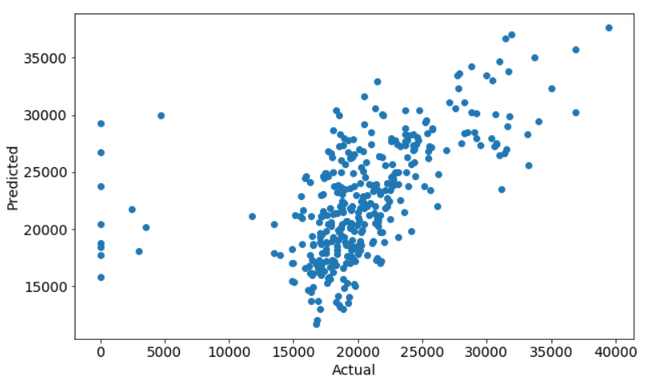
Scatter Plot of Predictions and Actuals

Slide 8
Next Steps
Next Steps:
Get Better Historical Weather Data.
Develop a methodology for estimating the missing Pepco Electricity Use data points.
Evaluate the efficacy of the model with more complete data then explore additional feature engineering and more sophisticated modeling (Random Forests, Ensembling, etc.)
Generate a model to predict the 2018 Weather-based features such that the current model can be used to generate electricity usage predictions for 2018.

Slide 9
Questions?

